Slide 1

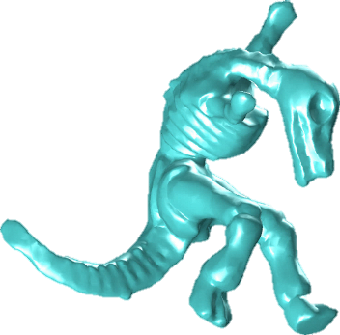
Geometry of orthogonal-series, square-root density estimators: Model selection and computer vision applications
Adrian M. Peter
apeter@fit.edu
Anand Rangarajan
anand@cise.ufl.edu
Mark Moyou mmoyou@my.fit.edu
Trevor Herntier therntier2007@my.fit.edu
Notes:
I want to thank the organizing committee for inviting me to this great venue. My talk to day will focus on THE GEOMETRY of orthogonal-series, square-root density estimators, with applications in computer vision and model selection. I want make sure and acknowledge my collaborators in this area…

Slide 2
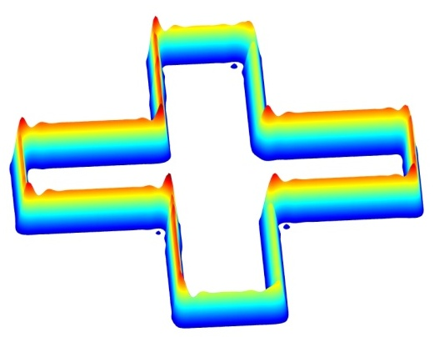
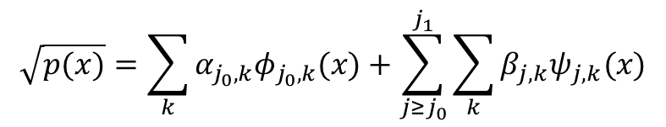
Overview
$$\sqrt{p(x)}=\sum_{k}{α_{j_{0},k}φ_{j_{0},k}(x)}+\sum_{j≥j_{0}}^{j_{1}}{\sum_{k}{β_{j,k}ψ_{j,k}(x)}}$$
MDL
Notes:
Since this talk is right after lunch, I tried to make it as pictorial as possible. In our vision applications, we focus on the area of shape analysis and shape matching, with the problem setting being that we are given 2D and 3D unstructured point-set representations of shapes and we must develop computationally efficient ways determining similarity between elements of a shape collection. In our framework, rather than work with the point set representations directly, we estimate a density function directly on the point set. Well, more precisely, we estimate the square-root of the density expanded in a wavelet basis. Under such a representation it can be shown that…Rather than a shape matching problem, we’ve now converted it to a density matching problem.
It also turns out that we can leverage the spherical geometry to do model selection using the MDL approach. In this context model selection amounts to….
The title can be bit of a mouthful so, let’s take a pictorial look of what we are here to discuss. In the past we have introduced a shape analysis framework where given a point set rep. of the shape, we estimate its probability density function by using a model that expands the square root of the density in a wavelet basis.
…
Today will we focus on how we can also use the spherical geometry to do model selection via MDL. Model selection in this paradigm amounts to appropriately selecting the starting and ending decomposition levels of the wavelet expansion. So MDL is going to give us a principled manner by which to choose the best density given a finite sample of data.

Slide 3
Square-root Wavelet Density Estimation

Slide 4
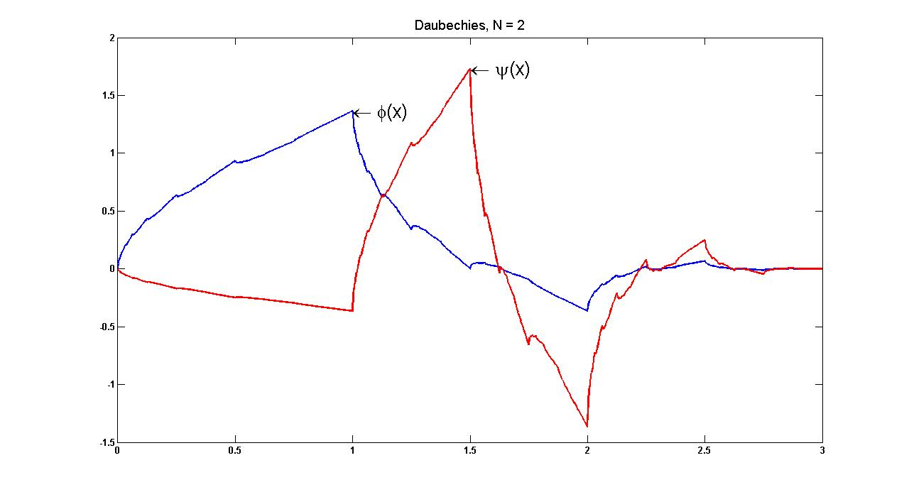
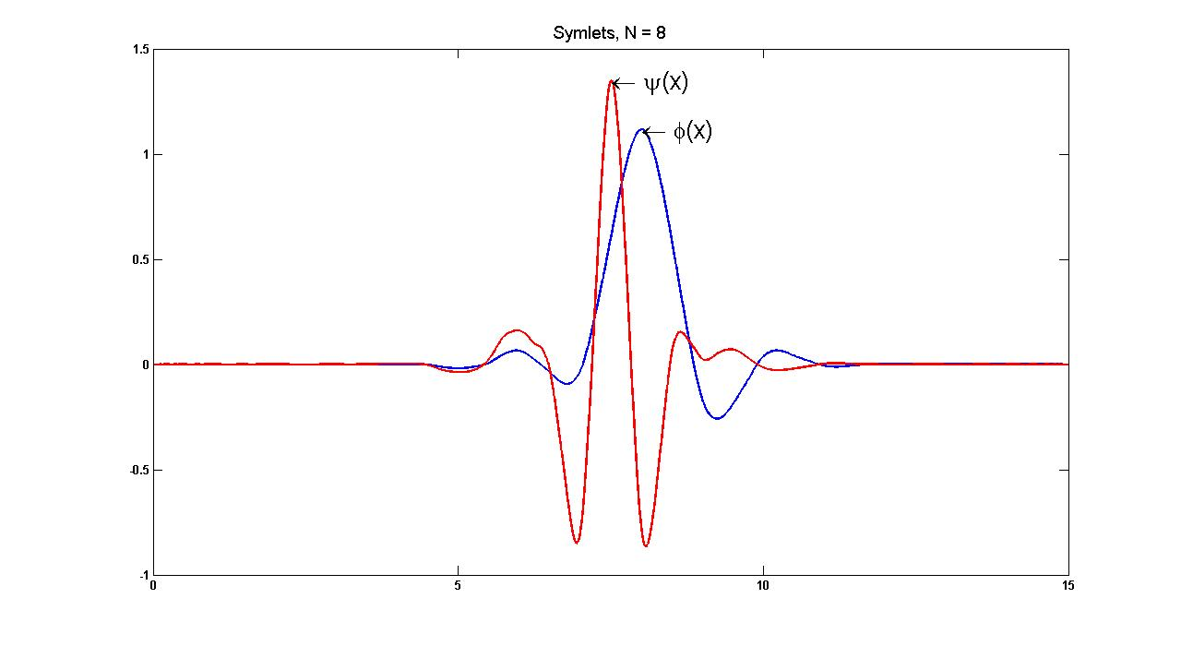
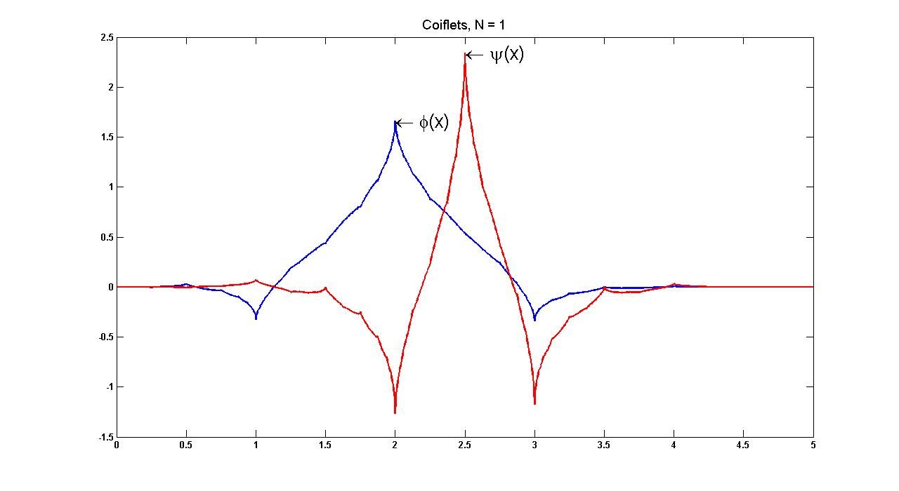
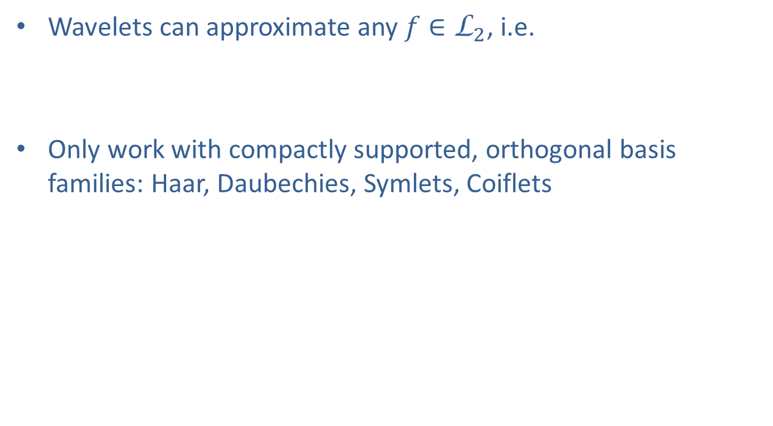
Wavelet Representations
Square-root Wavelet Density Estimation
Father
Mother
Wavelets can approximate any $f∈{\text{L}}_{2}$, i.e.
Only work with compactly supported, orthogonal basis families: Haar, Daubechies, Symlets, Coiflets
Translation index
Resolution level
Daubechies
Symlet
Coiflet
Notes:
The approximation power of wavelets is well known as they are a basis for any L2 function. A function expanded in a multiresolution wavelet basis is represented by a combination of father and mother wavelets. In the expansion the k index represents the spatial translation of the basis and j the resolution level.

Slide 5
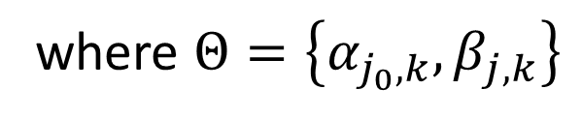
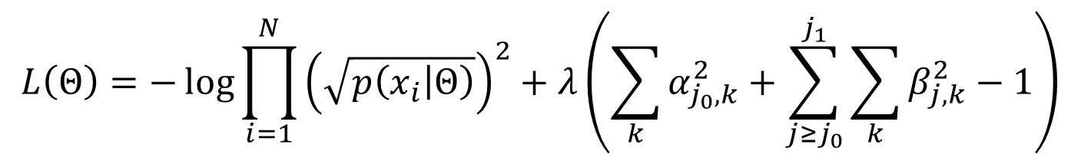
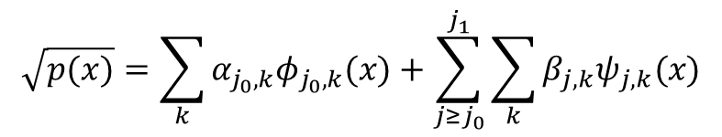
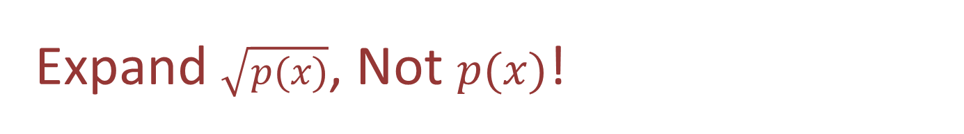
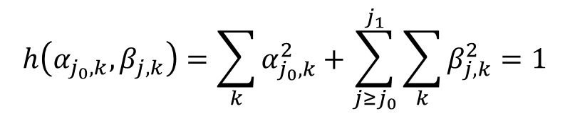
Expand $\sqrt{p(x)}$, Not $p(x)$!
Square-root Wavelet Density Estimation
Expand in multi-resolution basis (sqWDE model):
Integrability constraints:
Estimate coefficients using a constrained maximum likelihood objective:
$$\sqrt{p(x)}=\sum_{k}{α_{j_{0},k}φ_{j_{0},k}(x)}+\sum_{j≥j_{0}}^{j_{1}}{\sum_{k}{β_{j,k}ψ_{j,k}(x)}}$$
$$h\left(α_{j_{0},k},β_{j,k}\right)=\sum_{k}{α_{j_{0},k}^{2}}+\sum_{j≥j_{0}}^{j_{1}}{\sum_{k}{β_{j,k}^{2}}}=1$$
$$L\left(Θ\right)=−\log{\prod_{i=1}^{N}{{\left(\sqrt{p\left(x_{i} | Θ\right)}\right)}^{2}}}+λ\left(\sum_{k}{α_{j_{0},k}^{2}}+\sum_{j≥j_{0}}^{j_{1}}{\sum_{k}{β_{j,k}^{2}}}−1\right)$$
where $Θ=\left\{α_{j_{0},k},β_{j,k}\right\}$

Slide 6
1D Density Estimation
Square-root Wavelet Density Estimation
Notes:
Here are some examples of the 1D density estimation with wavelets. The green line is the truth, the red the wavelet density and the blue line is the standard kernel density estimator. We can see that for highly varying densities such as this claw density, the wavelet density estimator does an excellent job of capturing all the peaks whereas the KDE fails.

Slide 7
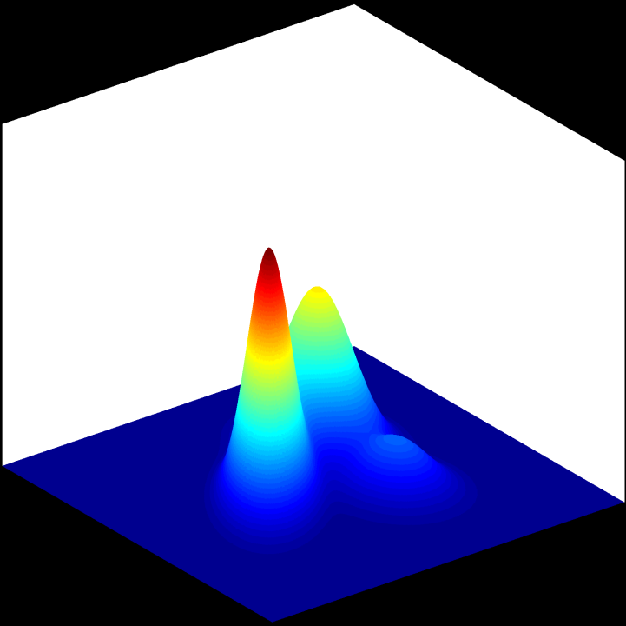
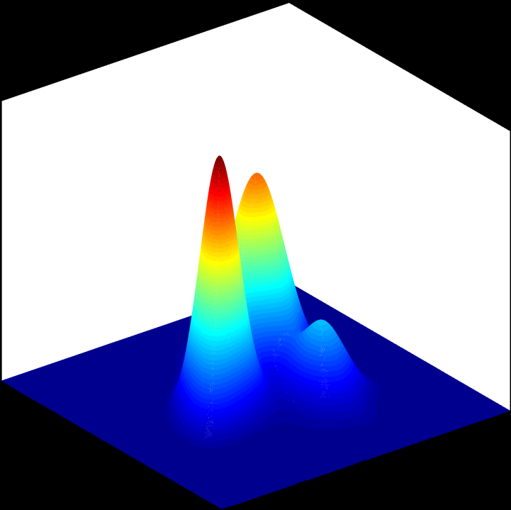
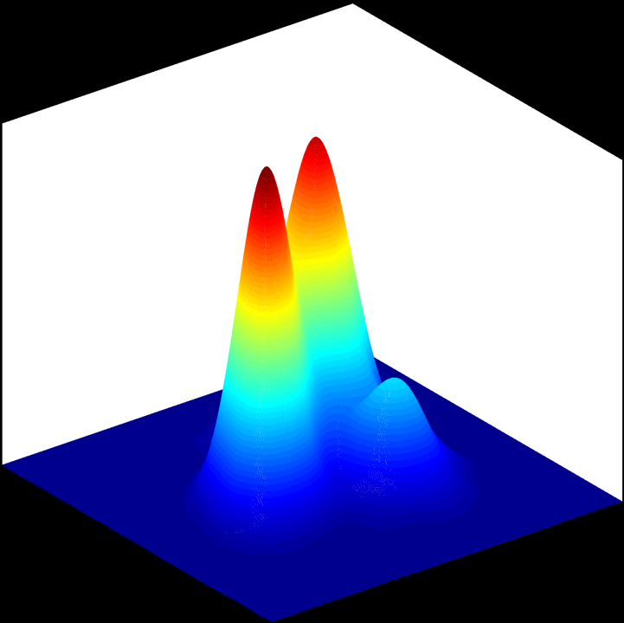
2D Density Estimation
Square-root Wavelet Density Estimation
True Trimodal
sqWDE
KDE
Notes:
Discuss results…
So how can we in a principled manner select the j0 and j1 of our expansion? Any particular choice of j0 and j1 gives us a particular model class, so hence we want the ability to choose between competing model classes. This is where model selection comes into play.

Slide 8
Shape Matching and Retrieval

Slide 9

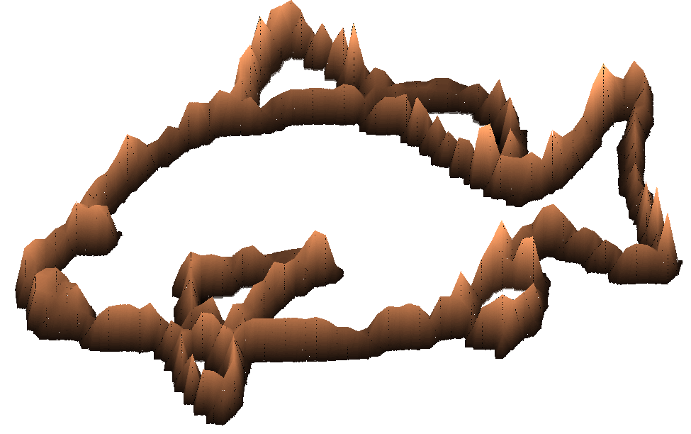
Geometry of Shape Matching
Shape Matching and Retrieval
Shape is
a point on hypersphere!
Point set representation
Wavelet density estimation
Fast Shape Similarity Using Hellinger Divergence
Or Geodesic Distance
Notes:
Now that we know how to estimate the densities and see that the densities visually resemble the original shapes, how do we go about matching them? So given a point set, we can estimate the wavelet density. The constraints on the coefficients immediately map this to a unit hypersphere. Now there are actually two closed-form similarity measures we can use to match the densities. The first is the Hellinger divergence and the second is just the geodesic distance on the unit hypersphere. In both measures it is really the inner product between the coefficients that is the driving factor. In this early version of our framework we are assuming that shapes are roughly affine aligned, hence there could be still non-rigid differences between them. So to gain a higher level of accuracy we will now discuss how to adjust for nonrigid distortions between shapes by simply permuting coefficients of their density representation.

Slide 10
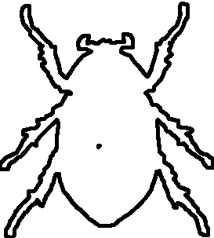
Localized Alignment Via
Shape Matching and Retrieval: Regularized Optimal Transport
Sliding
Local shape differences will cause coefficients to shift.
Permutations ⇒ Translations
Slide coefficients back into alignment.
Notes:
Here are a couple of motivating examples as to why we to slide the coefficients before matching. Basically using movement of wavelet basis to accomplish non-rigid alignment (as seen from the resolution level of the wavelet decomposition) between shapes. If we just blindly solve for a permutation between coefficients, every shape can be essentially transformed to another shape. What we need to do is penalize the sliding.

Slide 11
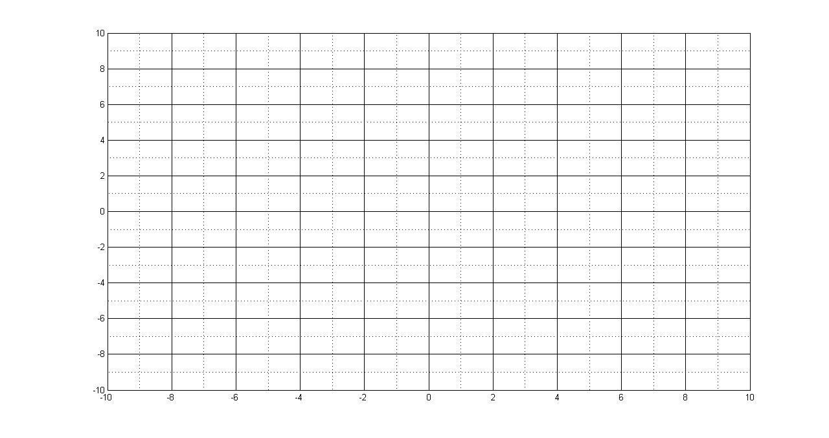
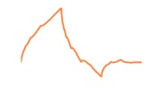
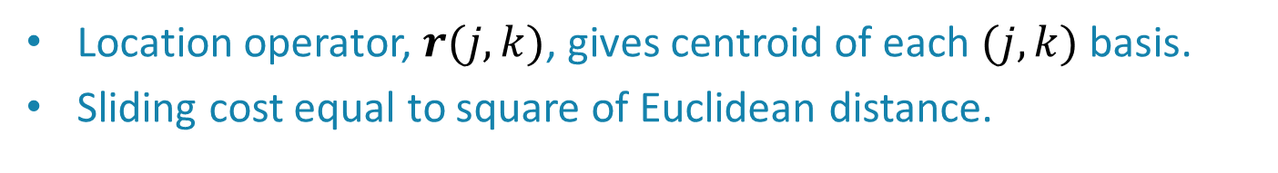
Penalize Excessive Sliding
Shape Matching and Retrieval: Regularized Optimal Transport
Penalize for large movements
Location operator, $r(j,k)$, gives centroid of each $(j,k)$ basis.
Sliding cost equal to square of Euclidean distance.
Notes:
Sine we are only interested in adjusting for localized non-rigid deformations, we develop a simple penalty that does not allow a coefficients to be spatially translated too far. When you estimate a density for a shape you can think of it as having the wavelet basis functions spread out over your grid. If it was a rectangular shape only the coefficients with associated with those basis would be lit up. Then we have sliding penalty that is equal to the square of the Euclidean distance. This will force the permutations to be localized.

Slide 12
Sliding Objective
Shape Matching and Retrieval: Regularized Optimal Transport
Objective minimizes over penalized permutation assignments
Solve via linear assignment using cost matrix
where Θ_{i} is vectorized list of i^{th} shape’s coefficients and D is the matrix of distances between basis locations.
Location operator
Permutation
Penalty Weight
Notes:
We can put the two ideas together of finding the permutation between coefficients and not allowing for large movements into the following objective. So when matching two shapes you just create a the cost matrix for the linear assignment solver by taking the outer product between the coefficients and then tacking on lambda times the distance plenty matrix.
We use LAP solver by R. Jonker and A. Volgenant.

Slide 13
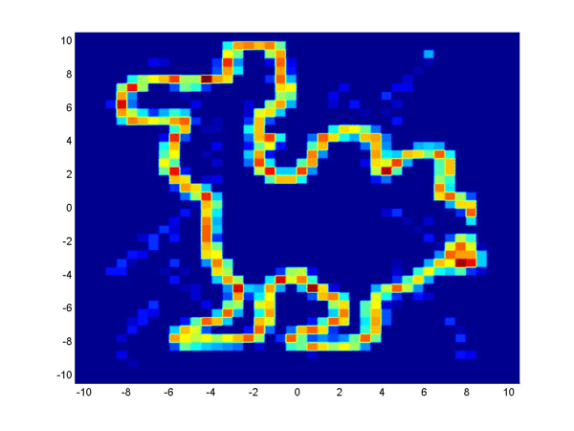
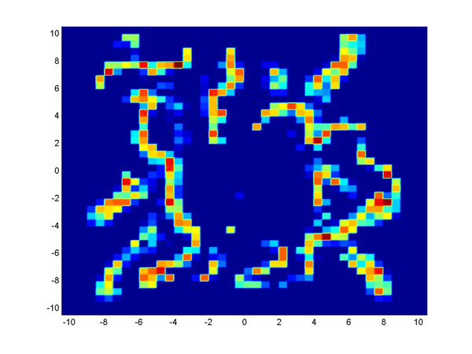
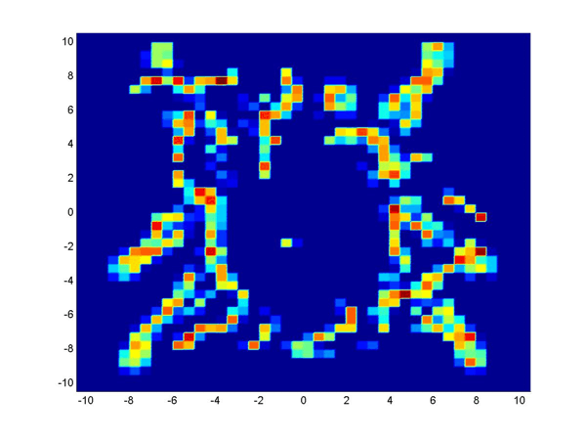
Effects of λ
Shape Matching and Retrieval: Regularized Optimal Transport
T
S
λ=10
λ=500
λ=1000
Notes:
Now we want to illustrate the effects of the lambda parameter. Here we have two shapes estimated using the Haar basis. We can see when the lambda is low, the soruce shape, beetle, is able completely transform itself to the target camel. As lambda increases the sliding becomes more localized and one shape is not able to completely transform itself to the other.

Slide 14
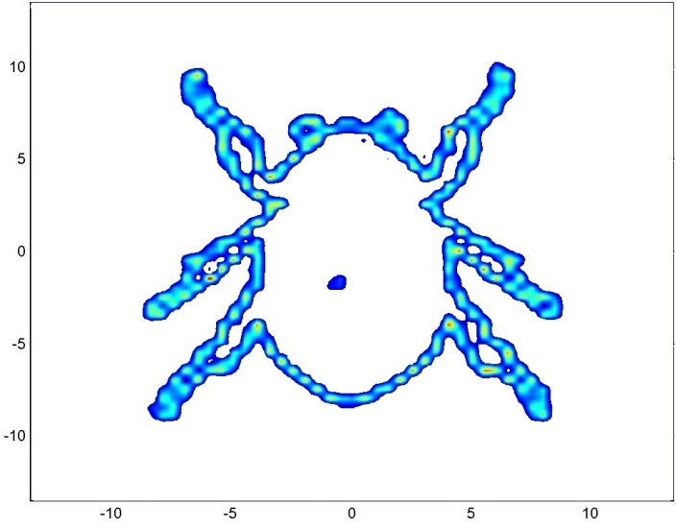
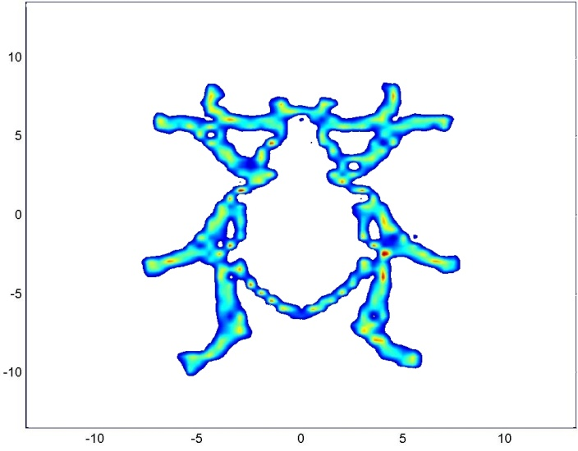
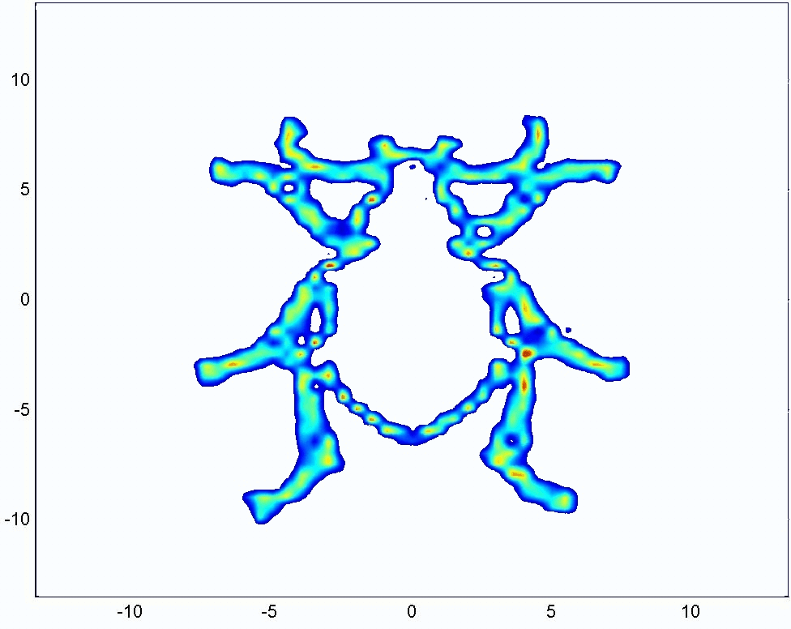
Sliding with Symlets
Shape Matching and Retrieval: Regularized Optimal Transport
T
S
Notes:
All of our preliminary work was with the Haar basis but this framework can be applied to of the other compactly support basis I showed earlier. Here is an example of the deformations using a symlet basis.

Slide 15
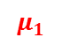
Karcher Means for Shape Classification
Shape Classification using Intrinsic Means on a Hypersphere
$$\sqrt{p(x)}=\sum_{k}{α_{j_{0},k}φ_{j_{0},k}(x)}+\sum_{j≥j_{0}}^{j_{1}}{\sum_{k}{β_{j,k}ψ_{j,k}(x)}}$$
$$μ_{1}$$
$$μ_{2}$$

Slide 16
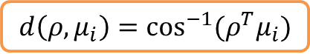
Classification of Shapes
Shape Classification using Intrinsic Means on a Hypersphere
Given exemplar shapes from multiple shape categories
The mean density of each class is computed using a random subset of the associated densities in each class
Given a query shape:
Estimate its wavelet density
Compute the distance from the query shape density to each of the class mean densities using the closed-form distance on the hypersphere
The query shape belongs to the class with the minimum distance
$$d\left(ρ,μ_{i}\right)=\cos^{−1}{(ρ^{T}μ_{i})}$$
Note that all our analysis is taking place intrinsically on the manifold of our shape representation
an advantage over methods that decouple representation and matching
Vectorized set of wavelet
coefficients for the query
shape density
Set of wavelet coefficients for the mean
shape density of the ith class
Notes:
Given a number of shapes from multiple shape categories
The mean density of each class is computed using a random subset of the associated densities in each class.
Given a query shape
We estimate its wavelet density
Then we compute the distance from the query shape density to each of the class mean densities using the closed-form distance on the hypersphere.
The closed form distance is the inverse cosine of the inner product between the mean shape and the query shape.
The query shape belongs to the class with the minimum distance
A key point to note is that all our analysis is taking place intrinsically on the manifold of our shape representation an advantage over methods that decouple representation and matching.
We chose to validate our shape matching approach using the popular mpeg 7 shape 1 part b database.

Slide 17
Experimental Results
Shape Classification using Intrinsic Means on a Hypersphere
Our approach is very stable with recognition rates
exceeding 95% even with less than half
the number of shapes per category to compute the mean
Notes:
Here you see the box plot obtained from our implementation on the MPEG 7 data set
The x-axis shows the number of shape densities used to calculate the mean shape density.
The y-axis denotes the classification accuracy.
Notice that our peak accuracy was just above 97% with 20 shapes used to calculate the mean.
As you move along the x-axis, even with 10 shapes used to calculate the mean we still achieved a 95% classification accuracy.
Once can also see that the variability in the accuracies for each number of shapes was small, which confirms the robustness of the proposed approach.
So where does our method stand in comparison to the state of the art?

Slide 18

Related Work
Shape Classification using Intrinsic Means on a Hypersphere
A few methods are reporting rates above 85%
Hierarchical Procrustes: 86.35% (McNeill-Vijayakumar 2006)
Shape-trees: 87.7% (Felzenszwalb-Schwartz 2007)
Spectral Matching : 92.5% (Egozi, et al. 2007)
Affinity Learning on Tensor product graph: 99.99% (Yang-Latecki 2011)
Criterion | HP,ST, SM, ALTP | SqWavelet Density Representation
No topological restrictions
Large number of points per shape
Computationally efficient
Accuracy
Notes:
Some competing methods are shown here and all achieved greater than 85% accuracy.
All of the methods use the bull’s eye criterion to evaluate their methods
In the bull’s eye criterion a shape is presented as a query and the total number of correct matches out of the top 40 matches are used as the score.
Our method one the other hand uses the similarity metric on the space and classifies the shape as being in the class or not.
---------------------------------------------------------------------------------------------------------------------------------------------------------
The competing methods lose descriptive power by not by allowing arbitrary shape topologies and unconstrained point sets cardinalities.
In Heirarchichal procrustes from McNeill shapes, are represented by N =100 ordered points taken at equal intervals along the shape’s boundary.
In Shape trees from Schwartz, matching shapes is based on a hierarchical description of their boundaries, Typical implementations only use 50 to 100 sample points per curve.
In spectral matching and Affinity learning on Tensor product graphs they required one to build an NxN graph over the database of N shapes to encode nearest neighbor information.
These method won’t scale well for large query applications.
All of the methods proved to be accurate
With the comparison to the state of the art complete we racap the highlights of our shape matching approach.
---------------------------------------------------------------------------------------------------------------------------------------------------------
Shape-trees: matching shapes based on a hierarchical description of their boundaries. Matching proceeds by forming binary tree on contour points by breaking into end-points and mid-point (node stores the location of a midpoint relative to the endpoints). Uses dynamic programming procedure to match trees (takes O(nm³) time overall, where n is points in first curve and m is the points in the second curve where you are trying to match). Typical implementations only use 50 to 100 sample points per curve. Sometimes form 2 to 4 shape trees if there are bad sub-curve matches and pick the best.
---------------------------------------------------------------------------------------------------------------------------------------------------------
Egozi’s Spectral matching and meta similarity, Shapes were represented by discrete curves of which the points were ordered. The authors present a shape matching scheme that combines Local Shape Descriptors and global shape constraints using pairwise geometric similarities. They base their affinity measure on purely geometric measures. The shape matching method can be applied with any combination of shape descriptors and geometric distance measures. The inner-distance shape context and inner shape geodesic distances were used as shape descriptors.
The meta shape similarity does not propagate similarities on the graph but compares local graph structures as an intrinsic similarity measure.
---------------------------------------------------------------------------------------------------------------------------------------------------------
Hierarchical Procrustes -- matching progressively smaller boundary segments. Longer segments that have already been matched provide initial matches for the shorter segments, which can then slide and stretch/contract in order to find the best matches at this smaller scale. Find correspondence between point sets assuming cyclic ordering of points. Chop up curve into segments of different lengths all totaling 100. Compute match of current segment to other shape’s segments using Procustus distances (PD). At next level use match from previous level, to initialize.
---------------------------------------------------------------------------------------------------------------------------------------------------------
Yang and Latecki’s method begins with the creation of a weighted graph determined by the initial pairwise similarity values. They construct a tensor product graph and propagate the similarity information on this TPG using a graph diffusion process. The TPG allows them to obtain higher order similarity information. They however develop a method of extracting the information from this TPG and actually do the computations on the original graph which saves computational time.
In their implementation they used the Aspect Shape context (ASC) and Articulated Invariant Representation (AIR) as the input pairwise distance measure.
Aspect Shape context (ASC) : They embedded a 2d image or shape as a surface in 3 dimensions with a parameter named aspect weight and this forms an aspect space. The aspect weight controls the degree of deformation. The shape descriptor aspect shape context uses geodesic distances in the aspect space to compare shapes.

Slide 19
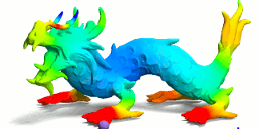
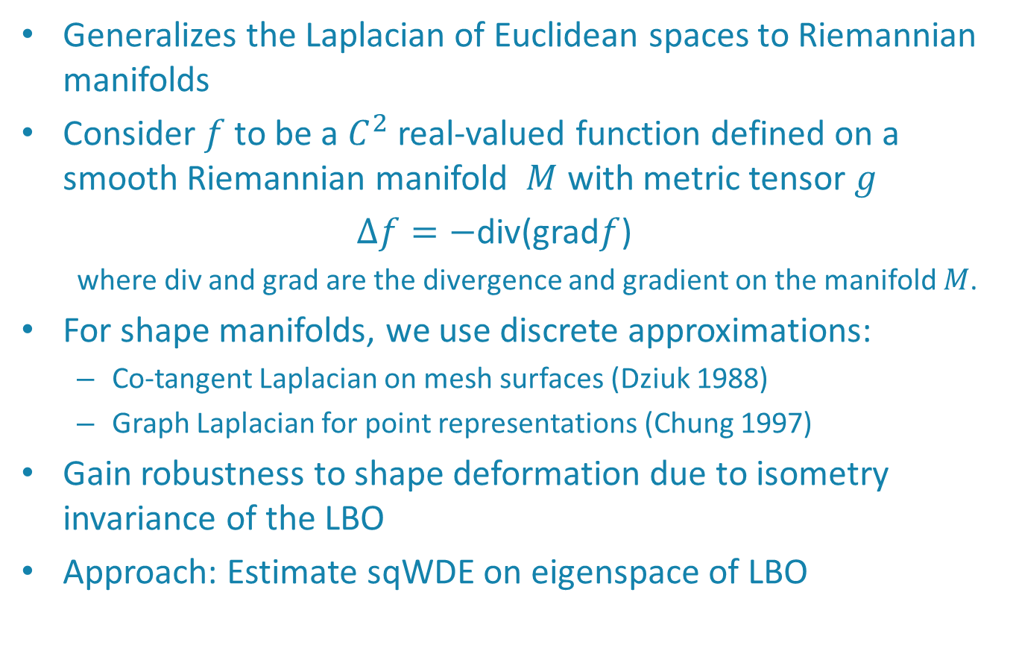
Laplace-Beltrami Operator (LBO) Shape Analysis
Shape Classification using Intrinsic Means on a Hypersphere
Generalizes the Laplacian of Euclidean spaces to Riemannian manifolds
Consider $f$ to be a $C^{2}$ real-valued function defined on a smooth Riemannian manifold $M$ with metric tensor $g$
$Δf=−$div(grad$f$)
where div and grad are the divergence and gradient on the manifold $M$.
For shape manifolds, we use discrete approximations:
Co-tangent Laplacian on mesh surfaces (Dziuk 1988)
Graph Laplacian for point representations (Chung 1997)
Gain robustness to shape deformation due to isometry invariance of the LBO
Approach: Estimate sqWDE on eigenspace of LBO
Notes:
The LBO is the generalization of the Laplacian to Riemannian manifolds
Consider a square intergrable function f defined on a Riemannian manifold M with a metric tensor g, then the LBO acting on the function f is the divergence of the gradient of that function
More specifically, in local coordinates we have the expression in terms of the metric tensor
Since we a working on finite 3D meshes we must discretize this operator on the approximated surface

Slide 20
LBO Eigenvectors
Shape Classification using Intrinsic Means on a Hypersphere
Low order eigenvectors
capture low frequency modes
High order eigenvectors
capture more detailed
geometric information
Notes:
The figures you see on the right are the individual eigenvectors plotted as a function on the surface of the 3D mesh.
The low order eigenvector capture the low frequency modes and contain more general geometric information
The higher order eigenvector capture more geometric detail
Knowing the type of geometric information that the low order eigenvectors contain, we look at some eigenshapes formed using these eigenvectors

Slide 21
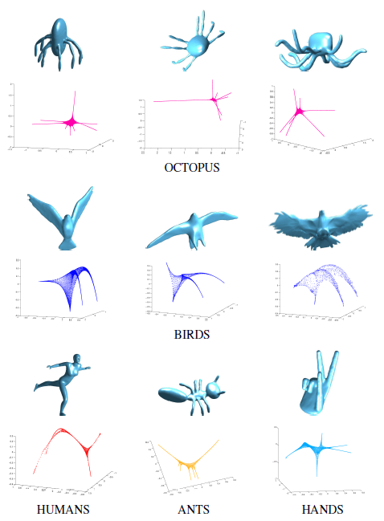
Eigenshapes
Shape Classification using Intrinsic Means on a Hypersphere
Eigenshapes are similar
within categories
Eigenshapes are different
between categories
Notes:
The 1,2,5 eigenvector triplet provided enough general information within the category from the 1st and 2nd eigenvector with the categorical differentiation coming from the 5th eigenvector.
The eigenshapes within a category are similar and different across categories, this provided a valuable 3D point set representation that be used to estimate a 3D non-parametric square-root wavelet density.
But before we get into wavelet density estimation, we first look at the wavelet series expansion

Slide 22
Model-to-Mean Retrieval
Shape Classification using Intrinsic Means on a Hypersphere
Create the mean index
Compute a mean shape density for class using the Karcher mean algorithm
Collection of mean shape densities serves as the new index for retrieval
Given a query shape:
Estimate a 3D square-root wavelet density on its associated eigenshape
Compute the distance from the query shape density to each entry in the mean index using the closed-form distance on the hypersphere
$$d\left(ρ,μ_{i}\right)=\cos^{−1}{(ρ^{T}μ_{i})}$$
Order the retrieval list with consecutive categorical members
based on the increasing distance of the query shape density
to each entry in the mean index
Vector of wavelet
coefficients for the query
shape density
Vector of wavelet coefficients for
the ith entry of the mean index
Notes:
Given a number of shapes from multiple shape categories
The mean density of each class is computed using the associated densities in each class.
The collection of these mean densities is called the mean index and is used as the new index to retrieve relevant shapes
Given a query shape
We obtain the eigenvectors of the LBO and estimate the coefficients of a 3D square-root wavelet density.
Then we compute the distance from the query shape density to each of the class mean densities using the closed-form distance on the hypersphere.
The closed form distance is the inverse cosine of the inner product between the mean shape and the query shape.
The retrieval list is then ordered with all the consecutive categorical members based on the increasing distance of the query shape the mean index entries
A key point to note is that all our analysis is taking place intrinsically on the manifold of our shape representation an advantage over methods that decouple representation and matching.
We chose to validate our shape matching approach using 4 datasets and several standard evaluation metrics

Slide 23
MDL Model Selection

Slide 24
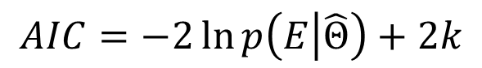
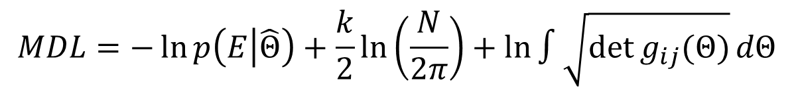
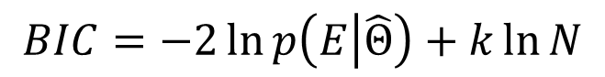
Balancing Accuracy and Complexity
MDL for sqWDE MRA Level Selection
“Pluralities are never to be put forward without necessity.” William of Ockham (Ockham’s razor)
Model selection criteria are a balance of accuracy and complexity
Akaike Information Criterion (AIC) (Akaike 1973)
Bayesian Information Criterion (BIC) (Schwarz 1978)
MDL has an extra term that penalizes based on the volume occupied by the model’s manifold in the space of probability distributions (Rissanen 1978)
Rewards paucity of parameters
$$AIC=−2\ln{p\left(E | \hat{Θ}\right)+2k}$$
$$BIC=−2\ln{p\left(E | \hat{Θ}\right)+k\ln{N}}$$
$$MDL=−\ln{p\left(E | \hat{Θ}\right)+\frac{k}{2}\ln\left(\frac{N}{2π}\right)}+\ln{∫\sqrt{\det{g_{ij}(Θ)}}dΘ}$$
Notes:
Select models that are accurate and simple.
E is the evidence (current observed samples). Θ is the maximum likelihood estimate of the parameters. N is the number of samples. k is the cardinality of the model parameters.
Psychophysics is a discipline within psychology that quantitatively investigates the relationship between physical stimuli and the sensations and perceptions they effect.
Stevens' power law is a proposed relationship between the magnitude of a physical stimulus and its perceived intensity or strength.
The goal of all model selection criteria is to balance accuracy and complexity. This desire is captured in Ockham’s razor which states: … . So let’s take a look at how two very popular model selection criteria AIC and BIC achieve this balance. AIC is … and BIC is … , where (explain symbols). Both measure accuracy using the log likelihood and complexity is measured in terms of the number of parameters in the model. So models with a large number of parameters are penalized more. BIC also incorporates the number of samples.
MDL has similar first two terms, but it also has an additional term that penalizes based on the total volume the model class occupies in the space of distributions. Here g_ij is the Fisher information matrix of the distribution, the square root of the determinant of which gives you the local infinitesimal Riemannian volume. This you can integrate over the entire parameter space of your model class to get the total volume.
Originally Rissenan derived MDL using coding theory arguments. Now let’s take a look at how we can arrive at the same result from a completely geometric point of view.

Slide 25
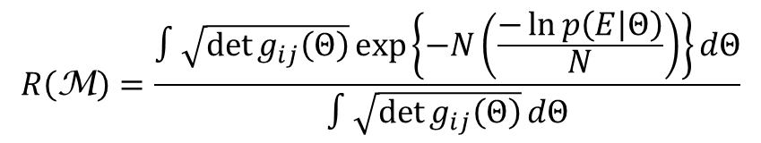
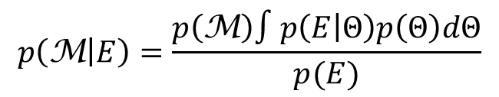
Geometric Derivation of MDL
MDL for sqWDE MRA Level Selection
Balasubramanian (1997) proposed geometric approach by analyzing the posterior of a model class M
Substitution of the Jeffreys prior and sample likelihood yields the razor
Application of Laplace approximation around MLE results in
More simply
$$p\left(\text{M} | E\right)=\frac{p\left(\text{M}\right)∫p\left(E | Θ\right)p\left(Θ\right)dΘ}{p(E)}$$
$$R\left(\text{M}\right)=\frac{∫\sqrt{\det{g_{ij}\left(Θ\right)}}exp\left\{−N\left(\frac{−\ln{p\left(E | Θ\right)}}{N}\right)\right\}dΘ}{∫\sqrt{\det{g_{ij}\left(Θ\right)}}dΘ}$$
$$R\left(\text{M}\right)≈ −\ln{p\left(E | \hat{Θ}\right)+\frac{k}{2}\ln\left(\frac{N}{2π}\right)}+\ln{∫\sqrt{\det{g_{ij}\left(Θ\right)}}dΘ}+\frac{1}{2}\ln\left(\frac{\det{{\tilde{g}}_{ij}\left(\hat{Θ}\right)}}{\det{g_{ij}(\hat{Θ})}}\right)$$
Scales with parameters and samples.
Volume of model class manifold
Ratio of empirical Fisher to expected Fisher
ML fit
$$R\left(\text{M}\right)≈−\ln{p\left(E | \hat{Θ}\right)+\ln\left(\frac{V(\text{M})}{V_{\hat{Θ}}(\text{M})}\right)}$$
Total volume of manifold
Volume around ML
Notes:
Two distributions are said to be indistinguishable if the probability one is mistaken for the other is close 1 even in the presence of an infinite amount of data.
Jeffrey’s prior: “First, it is reparametrization-invariant so the same prior is obtained under all reparameterizations [3]. Second, Jeffreys’ prior is a uniform density on the space of probability distributions in the sense that it assigns equal mass to each “different” distribution [1]. In comparison, the uniform prior defined as \pi (\theta)=c for some constant c assigns equal mass to each different value of the parameter and is not reparametrization-invariant.” Myung
Bala showed that to achieve this one can begin from the posterior of a model class. Defined as …(discuss eq: likelihood and prior over parameters), where p(\theta) is the prior the parameter space of your model class. If we are comparing two model classes, then we can get rid of the prior on the model class (assuming equally likely) and the distribution over the evidence, which will be the same for both. Now all we are left with is the integral over the product of the likelihood and the prior.
The next step is substitute with the Jeffreys prior for the prior over the parameters and log likelihood over the assumed to be independent samples. What results is call the razor. Note that the use of the Jeffreys prior is key as it has two desirable properties: (1) reparametrization invariant and (2) allows us to consider only distinguishable distributions. Reparametrization invariance ensures that we are really counting distributions instead of parameters. The notion of distinguishable distributions really has to do with how well we can determine which distribution produced a finite sample. Given a finite sample we could have two very nearby distributions that could have produced the data. The infinitesimal volume measured by square root of determinant of the Fisher information gives us the ellipsoidal volume within which distributions are indistinguishable. (Even in the presence of an infinite amount of data.)
We then perform a Laplace approximation around the MLE, which gives the following 2nd order approximation to the razor. The terms …
A better geometric way of understanding the razor is to rearrange the terms to get it in the form of a accuracy plus complexity measure, which is the ratio of the total volume of the manifold to the volume around the ML estimate.
Hence when applied to model selection the razor and similarly MDL (the connection which we are about to make shortly) select models with the highest maximum likelihood per relative ratio of distinguishable distributions.

Slide 26
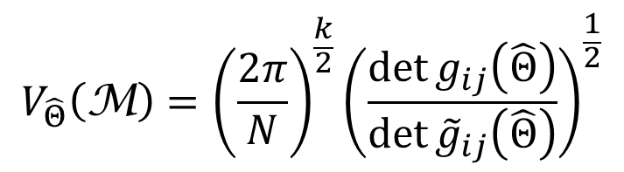
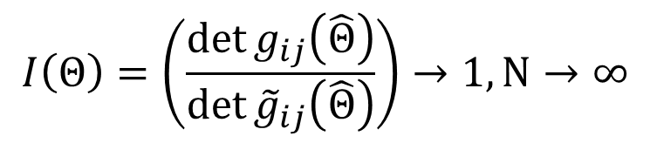
From the Razor to MDL
MDL Model Selection
Volume around MLE
As samples increase, the last term of razor disappears
This simplification leads to MDL
$$V_{\hat{Θ}}\left(\text{M}\right)={\left(\frac{2π}{N}\right)}^{\frac{k}{2}}{\left(\frac{\det{g_{ij}\left(\hat{Θ}\right)}}{\det{{\tilde{g}}_{ij}\left(\hat{Θ}\right)}}\right)}^{\frac{1}{2}}$$
$$I\left(Θ\right)=\left(\frac{\det{g_{ij}\left(\hat{Θ}\right)}}{\det{{\tilde{g}}_{ij}\left(\hat{Θ}\right)}}\right)→1,N→∞$$
$$R\left(\text{M}\right)→MDL=−\ln{p\left(E | \hat{Θ}\right)+\frac{k}{2}\ln\left(\frac{N}{2π}\right)}+\ln{∫\sqrt{\det{g_{ij}(Θ)}}dΘ}$$
Notes:
To make the connection to MDL, we start with the volume around MLE which is given by … Asymptotically, the ratio term becomes 1 as the empirical fisher converges to expected fisher. This immediately leads to the MDL formula we saw a couple of slides back.
For most models classes, you cannot compute this volume term in closed-form and typically would have to resort to truncating the parameter space and carrying out numerical integration procedures. It will turn out that for out square root wavelet density estimation models, this term is in closed-form since it is just the surface area of a unit hypersphere.
Before moving on, we are going to try to pictorially illustrate the behavior of MDL.

Slide 27
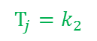
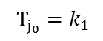
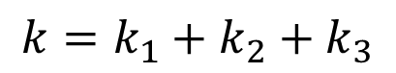
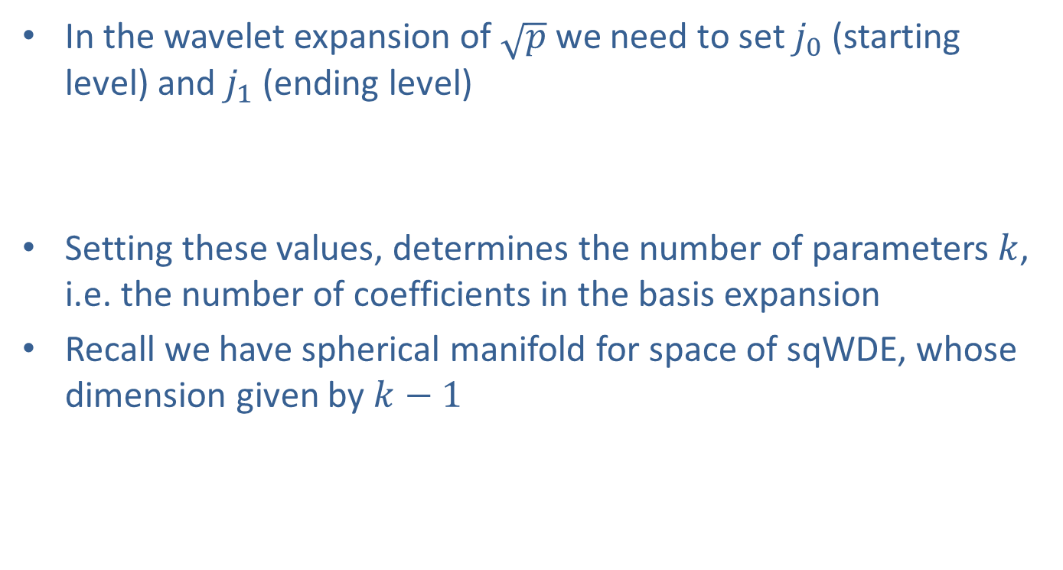
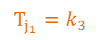
MDL for sqWDE Level Selection
MDL for sqWDE MRA Level Selection
In the wavelet expansion of $\sqrt{p}$ we need to set $j_{0}$ (starting level) and $j_{1}$ (ending level)
Setting these values, determines the number of parameters $k$, i.e. the number of coefficients in the basis expansion
Recall we have spherical manifold for space of sqWDE, whose dimension given by $k−1$
$T_{j_{0}}=k_{1}$
$$T_{j}=k_{2}$$
$$T_{j_{1}}=k_{3}$$
$$k=k_{1}+k_{2}+k_{3}$$
Notes:
Now let’s look at applying MDL to the square-root wavelet density estimator. Again, this amounts selecting the j0 and j1 parameters of the expansion, which are just the coefficients located at the translations indices. At each resolution level, we get number translations indices needed to cover the space with the basis functions having a support determined by the current resolution. The total of cardinality of all these coefficients is k, they have to sum square to 1, hence the intrinsic dimensionality of the unity hypersphere is k-1.

Slide 28
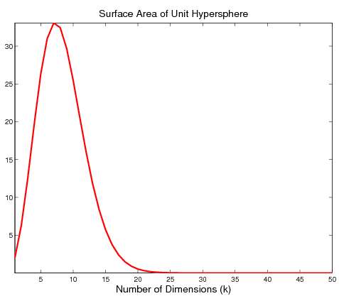
MDL for Wavelet Densities on the Unit Hypersphere
MDL for sqWDE MRA Level Selection
M_{n}
M₃
M₂
M₁
Dimensionality
...
Rapidly decreasing surface area of hypersphere.
Nested subspace structure of wavelet basis.
T
M₁⊂ M₂⊂ M₃⊂… ⊂ M_{n}
Space of distributions
Notes:
Before we can apply MDL to our square root density estimation model, there are couple of issues that we have to pay attention to. As the dimensionality increases of our unit hypersphere, the space of density functions which we can reconstruct are nested subspaces of each other. This is an immediate result of the nested subspace property of wavelets. But, since we are constrained to live on a unit hypersphere, it turns out that the surface area of the unit rapidly decreases to zero as the dimensions increase. Let’s take a closer look at both of these issues and how they impact MDL model selection.

Slide 29
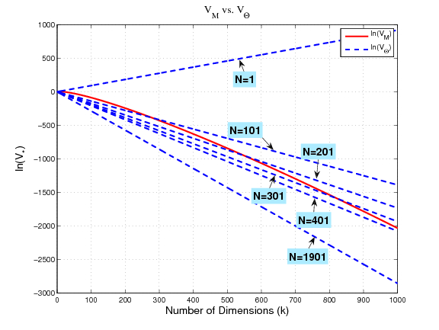
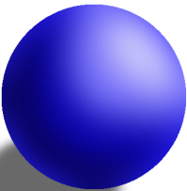
Shrinking Surface Area Addressed by Number of Samples
MDL for sqWDE MRA Level Selection
Must pay attention to misspecified models

Slide 30
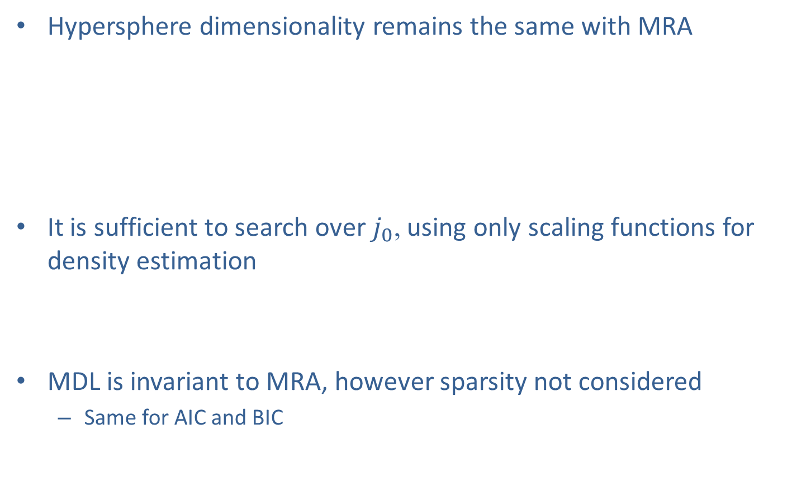
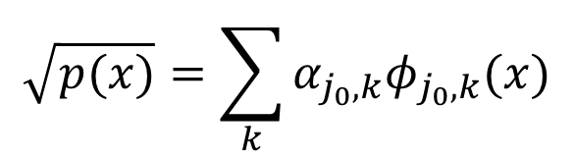
Nested Subspaces Lead to Simpler Model Selection
MDL for sqWDE MRA Level Selection
Hypersphere dimensionality remains the same with MRA
It is sufficient to search over $j_{0}$, using only scaling functions for density estimation
MDL is invariant to MRA, however sparsity not considered
Same for AIC and BIC
V₄=W₃⊕V₃=W₃⊕W₂⊕V₂=…
$$\sqrt{p(x)}=\sum_{k}{α_{j_{0},k}φ_{j_{0},k}(x)}$$
Notes:
Let’s denote the space of density function spanned by scaling functions at level 4 by V4. This space can be decomposed as a direct sum of two subspaces, one spanned by the wavelet functions at level 3 and the other by the scaling functions at level 3. This can again be decomposed to W2 and V2, and so on. Since there is a dyadic relationship between the subspaces, it turns out that the k coefficients needed to span V4 is the same number as needed by an MRA starting at some j0 and stopping at 3.
So MDL is invariant to MRA, but purpose of MRA is sparsity via thresholding. So one would have to investigative an alternative if sparsity is to be considered.

Slide 31
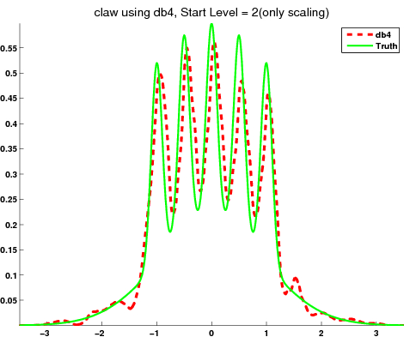
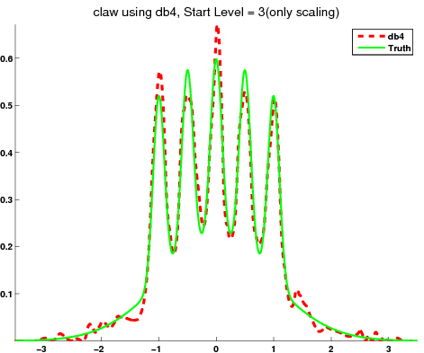


MDL³ vs. MDL²
MDL for sqWDE MRA Level Selection
MDL², j₀=2
MDL³, j₀=3
MDL², j₀=1
MDL³, j₀=2

Slide 32





MDL³ vs. BIC and MSE
MDL for sqWDE MRA Level Selection
BIC, j₀=0
MDL³, j₀=1
MSE, j₀=4
MDL³, j₀=2

Slide 33














2D Model Selection with Haar
MDL for sqWDE MRA Level Selection
Shape | j₀=-3 | j₀=-2 | j₀=-1 | j₀=0 | j₀=1 | j₀=2
MDL², BIC
MDL³, AIC

Slide 34

Revisiting MDL for Spherical Models
MDL for sqWDE MRA Level Selection
Recall from the geometric derivation of MDL:
These penalty terms result from performing the Laplace approximation around the MLE
$$\int{\exp\left(−\frac{N}{2}Θ^{T}{\tilde{g}}_{ij}Θ\right)dΘ={\left[\frac{{\left({2π}/N\right)}^{K}}{\det{{\tilde{g}}_{ij}(\hat{Θ})}}\right]}^{\frac{1}{2}}}$$
Here the integration is conducted over $ℝ^{k}$ assuming large sample asymptotics; What if we restrict integration to hypersphere?
$$R\left(\text{M}\right)≈ −\ln{p\left(E | \hat{Θ}\right)+\frac{k}{2}\ln\left(\frac{N}{2π}\right)}+\ln{∫\sqrt{\det{g_{ij}\left(Θ\right)}}dΘ}+\frac{1}{2}\ln\left(\frac{\det{{\tilde{g}}_{ij}\left(\hat{Θ}\right)}}{\det{g_{ij}(\hat{Θ})}}\right)$$
$$R\left(\text{M}\right)≈ −\ln{p\left(E | \hat{Θ}\right)+\frac{k}{2}\ln\left(\frac{N}{2π}\right)}+\ln{∫\sqrt{\det{g_{ij}\left(Θ\right)}}dΘ}+\frac{1}{2}\ln\left(\frac{\det{{\tilde{g}}_{ij}\left(\hat{Θ}\right)}}{\det{g_{ij}(\hat{Θ})}}\right)$$

Slide 35






Laplace Approximation on a Hypersphere
MDL for sqWDE MRA Level Selection
$${\left[\frac{{\left({2π}/N\right)}^{K}}{det⁡({\tilde{g}}_{ij}(\hat{θ})}\right]}^{\frac{1}{2}}$$
$$\int_{S^{k−1}}{}$$
$${{}_{1}F}_{1}\left(\frac{1}{2},\frac{k}{2},H\right)$$
$\exp\left(−\frac{N}{2}Θ^{T}{\tilde{g}}_{ij}Θ\right)dΘ$=
${{}_{1}F}_{1}\left(\frac{1}{2},\frac{k}{2},H\right)$ is the confluent hypergeometric function of matrix argument
$H$ is a diagonal matrix with the eigenvalues of ${\tilde{g}}_{ij}$ scaled by the sample size $N$

Slide 36

Spherical MDL
MDL for sqWDE MRA Level Selection
This changes the MDL criterion
$MDL=−\ln{p\left(E | \hat{Θ}\right)+\frac{k}{2}\ln\left(\frac{N}{2π}\right)}+\ln{∫\sqrt{\det{g_{ij}\left(Θ\right)}}dΘ}$
$MDL_{sph}=−\ln{p\left(E | \hat{Θ}\right)+}{\ln_{1}F}_{1}\left(\frac{1}{2},\frac{k}{2},H \right)+\ln{∫\sqrt{\det{g_{ij}\left(Θ\right)}}dΘ−\frac{1}{2}\ln\left(\det{g_{ij}\left(\hat{Θ}\right)}\right)}$
There is a difference in how the two criteria penalize complexity
The volume of the manifold is in common with the two penalties
The differences in penalty terms will yield different optimal models

Slide 37
Summary
sqWDE are excellent nonparametric models for a large class of density functions
Provide a simple spherical model for space of density functions
Well suited for 2D and 3D shape matching applications
MDL can be derived geometrically on the intrinsic space of distributions
MDL can be applied effectively to sqWDE provided we pay attention to
Shrinking surface area of unit hyperspheres (can lead to misspecified models but correctable through appropriate sample size)
Nested subspace property of wavelets (MDL invariant to multi-resolution expansions)

Slide 38


Questions

Slide 39
BACKUP

Slide 40
References
V. Balasubramanian: Statistical Inference, Occam's Razor, and Statistical Mechanics on the Space of Probability Distributions. Neural Computation 9(2): 349-368, 1997
A. Srivastava, I. Jermyn, and S. Joshi. Riemannian Analysis of Probability Density Functions with Applications in Vision , CVPR 2007.
A. Peter and A. Rangarajan, "Information Geometry for Landmark Shape Analysis: Unifying Shape Representation and Deformation," IEEE Transactions on Pattern Analysis and Machine Intelligence (PAMI), 2009.
A. Peter, A. Rangarajan and J. Ho, "Shape L'Âne Rouge: Sliding Wavelets for Indexing and Retrieval," IEEE Computer Vision and Pattern Recognition (CVPR), June, 2008.
A. Peter and A. Rangarajan, "Maximum Likelihood Wavelet Density Estimation with Applications to Image and Shape Matching,” IEEE Transactions on Image Processing (TIP), April, 2008.
J. Rissanen, Modeling by shortest data description, Automatica, vol. 14, pp. 465-471, 1978.
B. Parthasarathy and J.B. Kadane, Laplace Approximations to Posterior Moments and Marginal Distributions on Circles, Spheres, and Cylinders, The Canadian Journal of Statistics, 1991, 19, 67-77
G. Dziuk. Finite elements for the Beltrami operator on arbitrary surfaces. In Part. Diff. Eq. and Calc. of Var., pages 142–155. 1988.
Chung R.K. F. Spectral Graph Theory. Amer. Math. Soc., 1997.

Slide 41
Effects of λ
Shape L’Âne Rouge: Sliding Wavelets
T
S
λ=10
λ=500
λ=1000
Notes:
Now we want to illustrate the effects of the lambda parameter. Here we have two shapes estimated using the Haar basis. We can see when the lambda is low, the souce shape, beetle, is able completely transform itself to the target camel. As lambda increase we see less of the effects.

Slide 42
Sliding with Symlets
Shape L’Âne Rouge: Sliding Wavelets
S
T
Notes:
All of our preliminary work was with the Haar basis but this framework can be applied to of the other compactly support basis I showed earlier. Here is an example of the deformations using a symlet basis.

Slide 43

Recognition Results on MPEG-7 DB
Shape L’Âne Rouge: Sliding Wavelets
Geodesic Distance After LA
Max. = 85.25%
λ = 2250
Total Euclidean Distance
All recognition rates are based on MPEG-7 bulls-eye criterion.
Notes:
Talk about affine aligned versus improvement with non-rigid sliding. We also compared against D2 shape distributions, only 59.3% for Chi-Squared distance.

Slide 44
Related Work
Shape L’Âne Rouge: Sliding Wavelets
A few methods are reporting rates above 85%
Shape-trees: 87.7% (Felzenszwalb-Schwartz, CVPR 2007)
IDSC+EMD-L₁: 86.56% (Ling-Okada, PAMI 2007)
Hierarchical Procrustes: 86.35% (McNeill-Vijayakumar, CVPR 2006)
IDSC + DP: 86.4% (Ling-Jacobs, CVPR 2005)
Criterion | ST, HP, IDSC | Shape L’Âne Rouge
No topological restrictions
Large number of points per shape
Computationally efficient
Accuracy
Notes:
Shape-trees: matching shapes based on a hierarchical description of their boundaries. Form binary tree by breaking into end-points and mid-point (node stores the location of a midpoint relative to the endpoints). So, the dynamic programming procedure takes O(nm³) time overall (where n is points in first curve and m is the points in the second curve where you are trying to match). Only use 50 to 100 sample points per curve. Use the squared
Procrustes distance to decide if a point triplet is close to another. Sometimes form 2 to 4 shape trees if there are bad sub-curve matches and pick the best.
Hierarchical Procrustes -- matching progressively smaller boundary segments. Longer segments that have already been matched provide initial matches for the shorter segments, which can then slide and stretch/contract in order to find the best matches at this smaller scale. Find correspondence between point sets assuming cyclic ordering of points. Chop up curve into segments of differents lengths all totaling 100. Compute match of current segment to other shape’s segments using PD. At next level use match from previous level, to initialize.
IDSC --- inner-distance is defined as the length of the shortest path between landmark points within the shape silhouette. 1) Build a graph on the sample points. For each pair of sample points x; y, if the line segment connecting x and y falls entirely within the object, then build an edge between x and y with the weight equal to the Euclidean distance. 2) Apply shortest path algorithm to the graph, O(n³). Use IDSC to build histograms like Shape Context (which uses ED). For each point on shape we have histogram. Construction of histograms takes O(n²). To match histograms at points use Chi2 statistic just like SC.
Because these three work directly with the point representation, they don’t scale well computationally. We have added level of abstraction.

Slide 45
Conclusion
Each shape can have an arbitrary number of points without topological restrictions
Limited processing is required since we directly take the shape points and estimate the density
The similarity metric is in closed form and computationally efficient for large querying applications
Our approach was validated on the benchmarked MPEG 7 Shape database and demonstrated promising results which are competitive with the state of the art
Notes:
In our method we took shapes and represented them using the square root of the density function.
These shape densities lived on an n-dimensional unit hypersphere which was used to calculate a mean shape density
With these mean shape densities, classification was performed using the closed form distance on the hypersphere.
The advantages to our approach are
being able to represent shapes with an arbitrary number of points without topological restrictions.
There was limited preprocessing required since we directly estimate the density from the shape points.
Our similarity metric was in closed form and is computationally efficient for large query applications.
We validated our approach on the benchmarked MPEG 7 Shape database and demonstrated promising results that are highly competitive with the state of the art.
Thank you very much for your time! Are there any questions.

Slide 46

Laplace-Beltrami Operator (LBO)
LBO-Shape Densities
Generalizes the Laplacian of Euclidean spaces to Riemannian manifolds
Consider $f$ to be a $C^{2}$ real-valued function defined on a smooth Riemannian manifold $M$ with metric tensor $g$
$Δf=−$div(grad$f$)
where div and grad are the divergence and gradient on the manifold $M$.
In local coordinates,
$$Δf=\frac{1}{|g|}\sum_{i}{∂_{i}}\sqrt{|g|}\sum_{j}{g^{ij}∂_{j}f}$$
where $g^{ij}$ denotes the elements of the inverse of $g$
Notes:
The LBO is the generalization of the Laplacian to Riemannian manifolds
Consider a square intergrable function f defined on a Riemannian manifold M with a metric tensor g, then the LBO acting on the function f is the divergence of the gradient of that function
More specifically, in local coordinates we have the expression in terms of the metric tensor
Since we a working on finite 3D meshes we must discretize this operator on the approximated surface

Slide 47

3D Eigenshapes
LBO-Shape Densities
Eigenshapes are formed using a triplet of low order eigenvectors.
Constant eigenvector corresponding to $λ=0$ is removed
Eigenvectors corresponding to the smallest eigenvalues
Eigenvector triplet – (1,2,5) (determined experimentally)
The low order eigenvectors represent the low frequency modes of the shape
More robust to noise and deformations
Better suited for creating categorical shape protoypes
Contains information common to all shapes within a class
Notes:
Using a triplet of eigenvectors we form 3D eigenshapes,
To select the triplet we remove the constant eigenvector associtated with a lammda of zero
Using the 1st 2nd and 5th eigenvectors corresponding to the smallest eigenvalues we are able to see definitive looking eigenshapes that we will see on the next slide.
The goal was to obtain a point set representation in the eigenspace that reflected the shape similarity within a category and the differences across categories
By using low order eigenvectors we reduce the effect of noise and deformations in the meshes and are able to capture common geometric information within categories of shapes that allows us to compute better representative mean shapes.

Slide 48
Framework Evaluation
Experimental Results
3D datasets
SHREC’12 – Sketch-Based 3D Shape Retrieval Dataset (Basic version)
13 categories, 10 shapes per category
SHREC’11 – Shape Retrieval on Non-rigid 3D Watertight Meshes
30 categories, 20 shapes per category
SHREC’10 – Non-rigid 3D Shape Retrieval Dataset
10 categories , 20 shapes per category
SHAPE COSEG
8 categories, 12 shapes per category
Metrics
Nearest neighbor (NN), First Tier (FT), Second Tier (ST), E-Measure(EM), Discounted Cumulative Gain (DCG), Average Precision (AP), Precision-Recall curves (PR curves).
Notes:
Here are the four datasets used to evaluate this framework, only the SHREC’12 and Shape COSEG are available in the conference paper
We used the standard metrics in order to evaluated our performance
Next we discuss the experiments that we ran on these datasets

Slide 49

Model-to-Mean Evaluation

Slide 50
From the Razor to MDL
MDL Model Selection
Volume around MLE
As samples increase, the last term of razor disappears
This simplification leads to MDL
$$V_{\hat{Θ}}\left(\text{M}\right)={\left(\frac{2π}{N}\right)}^{\frac{k}{2}}{\left(\frac{\det{g_{ij}\left(\hat{Θ}\right)}}{\det{{\tilde{g}}_{ij}\left(\hat{Θ}\right)}}\right)}^{\frac{1}{2}}$$
$$I\left(Θ\right)=\left(\frac{\det{g_{ij}\left(\hat{Θ}\right)}}{\det{{\tilde{g}}_{ij}\left(\hat{Θ}\right)}}\right)→1,N→∞$$
$$R\left(\text{M}\right)→MDL=−\ln{p\left(E | \hat{Θ}\right)+\frac{k}{2}\ln\left(\frac{N}{2π}\right)}+\ln{∫\sqrt{\det{g_{ij}(Θ)}}dΘ}$$
Notes:
To make the connection to MDL, we start with the volume around MLE which is given by … Asymptotically, the ratio term becomes 1 as the empirical fisher converges to expected fisher. This immediately leads to the MDL formula we saw a couple of slides back.
For most models classes, you cannot compute this volume term in closed-form and typically would have to resort to truncating the parameter space and carrying out numerical integration procedures. It will turn out that for out square root wavelet density estimation models, this term is in closed-form since it is just the surface area of a unit hypersphere.
Before moving on, we are going to try to pictorially illustrate the behavior of MDL.

Slide 51
Convergence Rates
Maximum Likelihood Wavelet Density Estimation
Optimal:
Histograms:
KDE:
Linear WDE:
for
Non-linear WDE:
where
Notes:
For a Besov space with parameters (s,p,q). The parameter s is the degree of smoothness of the functions in the space, p refers to the Lp space in which the smoothness is measured, and q gives a more subtle measure of smoothness for a given (s,p) pair.

Slide 52



Highlight: Online Density Estimation
Wavelet Densities: Online Estimation
Developing robust, online density estimator based on wavelet theory
Essential tool in turning raw data streams into actionable intelligence for timely decision support

Slide 53
Online Density Estimation
Wavelet Densities: Online Estimation

Slide 54

Highlight: Cloud Computing for Big Data Analytics

Slide 55

Questions and Discussion

